Slide 1
Learning Network 2.0 Webinar Series Patient Engagement
Lori Higa, BSN, RN-BC & Ashley Heald, MA

Slide 2
Webinar/Group Case Call Series
Patient Engagement
Webinar: April 7, 2017
Group Case Call: April 28, 2017
Topic #2
Webinar: May 26, 2017
Group Case Call: June 23, 2017
Topic #3
Webinar: July 28, 2017
Group Case Call: August 25, 2017
Notes:
Ashley
At case call we can give topics for next and let them choose

Slide 3
Why is engagement important in IMPACT?
In studies, patients with early follow up were less likely to drop out and more likely to improve (Bauer, 2011)
What are your experiences with early engagement?
Notes:
Why is engagement important in Impact? If we cant figure out strategies and develop good skills to engage pt we lose the oppoturnity to have impact on what patient’s came in with to help them.
What are the factors that help patients and engage with care to really help them. This study identified that good early engagement contact from care managers, good intense contact, on average 2 times in the first month in the beginning, patients were more likley to engage in care, but if that enagement upfront was not there they were more likely to drop out and less likely to improve.
It’s really important to try to figure out strategies to help with difficult patients to engage. Some of you work in real rural areas or have cross cultural barriers that make engagmenet difficultt. So we are going to try to look at this is there a set of principles to help across the different kinds of settings, or across cultural factors that will help with patient engagment.
So what are some of the challenges, barriers that you all are experiencing, if anyone wants to share some of their struggles now it will help to set up todays subject? (Example too many people on my schedule so can’t get them in early enough, 1st appt is filled with information gathering and not in depth part of the session, Logistic barriers-- phone numbers are no longer working or patient’s are working)

Slide 4
Psychotherapeutic Process
Engagement
Assessment
Crisis management
Treatment → Depression
→ Anxiety
→ Behavioral Interventions
Notes:
This is a diagram that is a good example of where we are going with patients.
The center is the target what we are hoping to get to.
Starting with the outer circle in green is the engagement phase.
The blue is the assessment stage or step.
The purple is the crisis step, sometimes we are always working in the crisis stage, this many times has to get handled first.
The center is the phase where we actually get in to do the work with patients.

Slide 5
What happens when you have a patient difficult to engage?
What does the patient do?
What do you do in response?
Notes:
Can type in as we go
+ patient doesn’t come in; we do outreach
+ patient calls all the time; but we avoid them
+ patient says ok, but does nothing; we keep pushing for tx
+ patient doesn’t agree on goals; go through the motions
+ patient minimize symptoms
+ patient feels worse after treatment, you asked me to talk about all these things
+ once they feel the benefit of Rx but don’t’ see the need to talk anymore
What do you do in response?
Send a letter
Revisit old patterns with patient, try to get patient to see pattern
Validate- that this is hard to help them make sense of it

Slide 6
Key #1 Quality of Alliance determines outcomes (coaching, counseling, medicine, teaching, job training)
Strong alliance Good outcome
Weak alliance Poor outcome
Notes:
Let’s pull back and really look at how to build strong alliances. If the alliance is strong the outcomes improve.
Across all human helping relationships, the strength of the working alliance tells you how well things are going and strongly predicts future outcomes.
Next slide, look at the components of a strong alliance.

Slide 7
3 Critical elements of Alliance: (all 3 must be agreed upon by pt & prov)
Working
Alliance
Goals?
Tasks?
Bond?
Notes:
The Bond is really important, the patient needs to feel they are liked by you, they feel heard and that it’s ok to screw up and that it’s ok to be wrong. The bond is critical from the patient’s perspective, is the bond strong from their point of view, not necessarily from out point of view are we judging the bond. In order for the bond to be working critically in this alliance the bond has to be viewed from the patient’s perspective as strong.
The 2nd part of the alliance is the goals, having agreed upon goals between you and the patient. The first session is really important to make some headway, even at the detriment of the assessment, it’s important to get some agreement between eachother of what your shared goals are going to be working forward. If you don’t have the goals you don’t have an alliance. Goals can be team, overrarching goals, vs individual goals between clinicians.
The next part of is to develop the tasks
Bond: how much patient likes you, how much patient thinks you like them, to what degree patient trusts that if they make mistakes or don’t change yet that you won’t abandon them.
Goals: it’s critical that both patient and provider agree on what you are trying to accomplish together
Tasks: also critical that both agree on HOW to reach that goal.

Slide 8
Reciprocal causality (everything effects everything)
Patient
style
Provider style
Alliance
Notes:
All 3 wheels affect the others with reciprocating causality
The only one you can do anything about is your own wheel
What can you control?
Provider style
Patient says “I don’t need treatment”. We don’t have control of this statement.
What is the style that you have that control over that can be adjusted to change the dynamic of the alliance with the patient?

Slide 9
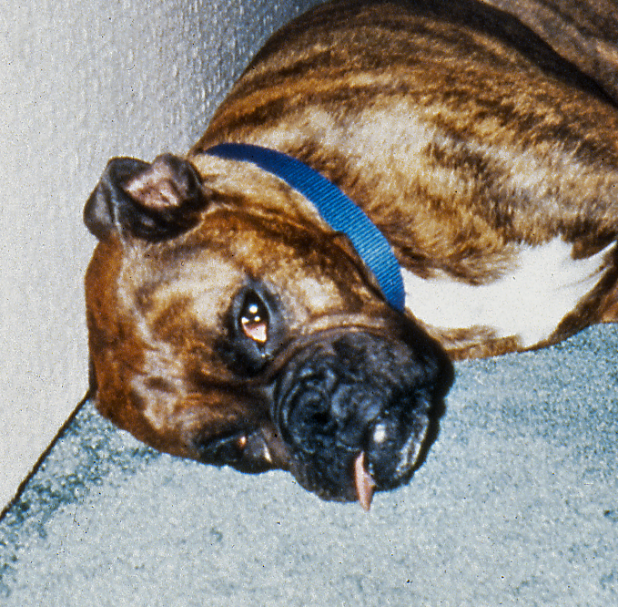
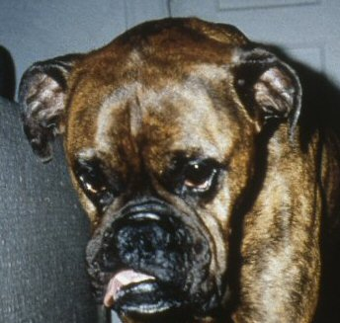
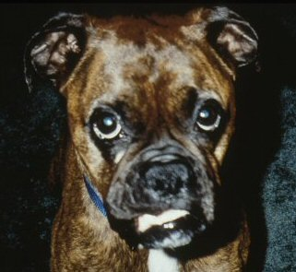
Key #2 Not ready to change / engage?
Not Ready On the Fence Ready
Notes:
Caveat: although we are going to tell you how to strengthen your working alliance as much as possible with a patient, please remember that a patient’s readiness level in part limits how strong your working alliance can be with them and also puts a ceiling TEMPORARILY on how much they can or will change.
Must assess readiness to change at the beginning of the session and at the end…
We must always be looking at readiness to change in our patients.
A lot of times patient is not ready to engage. They might be on the fence. They are ambivalent, we have to be assessing there state of readiness. How ready are you to see me? Patient might answer your call but may not make a call to you, or in many cases they answer their phone by accident. If you’re assuming readiness and they are still on the fence, and offering them an appointment, treatment and tasks when a patient isn’t ready to engage and just looking at you like this boxer. The patient is not ready to bend over backward to see you, they might be on the fence and talk you occassional but won’t make the effort to come in.

Slide 10
What does your patient do?
When they are not ready?
On the fence (ambivalence)

Slide 11
Assessing for readiness…
What brings you to see me? What are you expecting in this visit today?
What are you hoping to get from your care?
After behavioral health assessment…
Agree on the initial task to return for treatment
Set mutual goals
Notes:
I have no idea, they told me to see you.
This tells us their readiness. This tells us there’s some engagement work to do?
29 minute

Slide 12
Some Provider Potholes
Question and answer trap (closed questions)
Correcting wrong thoughts with rational explanations (telling them what to do)
Avoiding the patient (hiding, acquiescing with Rx)
What are some you notice?
Notes:
When there is poor alliance going on this is where closed questions can some times be a trap of a pothold.
“Mansplaining” responding with a rationale, the reflex is to be refelctive, reflect back the ambivalance this helps to build a space for the patient 32 seconds
When conditions make it tough to have a strong working alliance, different types of potholes present themselves
Sometimes potholes are fine… work fine.
What makes people more engaging or not?; can use this strategy to find out why people get disengaged

Slide 13
Rationale for Motivational Interviewing Style
If not listened to:
Secretive
Angry, annoyed
Avoidant
Oppositional
Discounting
If listened to:
Frank
Understood, accepted
Exploring
Cooperative
Concerned
Notes:
13
What’s behind MI
Feeling listened to by provider seems to be one of the best predictors of good outcomes. It contributes to bond, goals, and tasks being agreed upon

Slide 14
When to step up engagement
Lacking agreement on goals
Lacking agreement on tasks
Weak bond
At the beginning or over time…
Engagement can get thwarted!
Notes:
When you’re working patiets that it’s owrking all these things are working, but with difficult patients here is a place to reflect back on and
35 mintues

Slide 15
Ambivalence Example
My client struggles with ambivalence about change. One moment, she wants to take the plunge, and the next moment, she’s stuck again. She’s working hard to resolve this.
MI Inconsistent
MI Spirit
She’s manipulative. She tells me she wants to change, because she thinks it’s what I want to hear. But she’s really not motivated.
Notes:
Ambivalence is feeling 2 ways about change. Patients drift back and forth between pros and cons without trying to intentionally m37 nunanipulate you.
37 minutes

Slide 16
Reflections: Examples
It sounds like you are feeling…
MI Spirit
It sounds like you are not happy with…
It sounds like you are a bit uncomfortable about…
So you are saying that you are having trouble…
So you are saying that you are no so sure about …
You’re not ready to…
You’re having a problem with…
You’re feeling that…
It’s been difficult for you…
You’re struggling with…
What a pisser!
Notes:
Making someone feel listened to and understood is really as simple as reflecting back to them what they say.
It’s like holding up a mirror for them to hear themselves and to see where they are stuck.
Good reflections are merely GUESSES about what the patient just said. They don’t interpret. Every Reflection begins with a “stem” (sounds like…you must be…that must feel…if I were in your shoes, I would feel…)
Don’t sweat your stems, just try to make your guesses accurate
What’s the meaning behind their statement?
What might the feeling be behind their statement?
Guess need confirmation. You aren’t agreeing, you aren’t interpreting, you aren’t telling them what they should feel. This isn’t about you, it’s about your guess of what they think,. Mean, feel. It’s up to them to correct it.

Slide 17
Engagement Steps
Elicit the story = understanding, summary of pros/cons to tx
Elicit treatment hopes and dreams
Feedback = psychoeducation
Barriers: practical, psychological, cultural
Elicit commitment
Notes:
5 bullets
If engagement is weak, look at these 5 steps.
-What is the patients story, what would be the pros and cons of coming back to work with me today?
-If treatment is successful what would you see that things have gotten better? 44 minutes good examples
-Feedback- this is not within MI , we ask in MI if they are ready for education, ask permission to give the information? Jumpiing to psychoeducation, or pushing for change too fast, when they are ready to make changes yet. Do you think setting some goals would be helpful to do today?
Barriers- Nancy Gross talks about 3 areas, what are the PRATICAL barriers you anticipate having before we start working with me?
What are the psychological barriers- 50 minutes, do you think that is going to be hard to talk about?
Cultural barriers- are you quite different from the patient, can you ask about that up front? Issues of trust with their provider? Bring up these barriers that might make it hard to work in treatment. This a place to help align with the patient, problems solve or just sitting to hear what these barriers are. Brining these things upfront can be hugely aligning with the patient.
-Where to you eliciting commiment in MI we ask the full menu of options, Where do you see yourself going from here?
Drinking example
Do you see yourself increasing
Staying where your at
Do you see yourself going down in next couple weeks
Where do we go from here?
Do you see yourself not talking to me again
Do you see yourself just working with me if I just reach out to you
Or do you see yourself working to get back in for another appt
You can see when they come back in when they see the doctor.

Slide 18
Questions?

Slide 19
Selecting a case
Difficulty goal setting
Difficulty agreeing on tasks or follow through
Poor bond

Slide 20
Case document

Slide 21
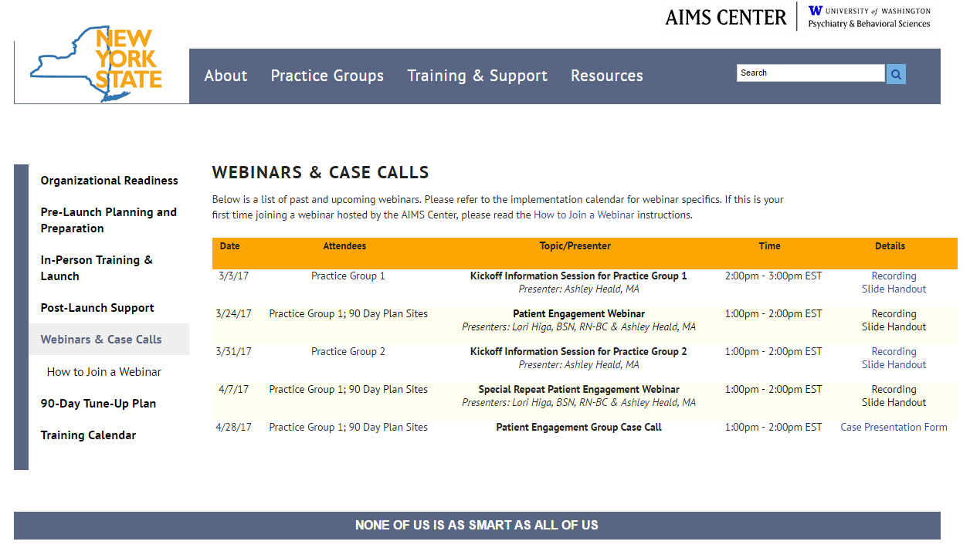
Webinar and Case Calls Page: http://aims.uw.edu/nyscc/training/content/webinars-case-calls

